Slide 1

CaptionGen:
Emotionally-Enriched Image Captioning
Group 7:
Antra Sinha, Ashwanth Sathishkumar, Barnana Ganguly, Dinesh Bandaru, Hayoung Kim

Slide 2
Table of contents
01
04
02
05
03
Context and Objective
Output
Data Exploration
Next Steps
Methodology

Slide 3
01
Context and Objective

Slide 4
Context and Objective
Objective: Enhance and adapt AI-generated captions for diverse user preferences and multilingual audiences
Base Process: Start with GPT-2 generated captions from images, using a combination of CLIP, Transformer Encoder, and Linear Layer
Customization Options:
Adjust caption tone (formal, casual)
Translate captions into different languages
Provide detailed information about specific items in the caption using NLTK and spaCy
CLIP
GPT-2
GPT 3.5

Slide 5
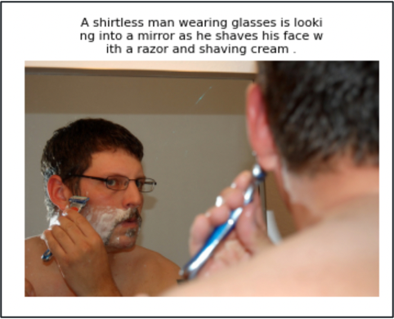
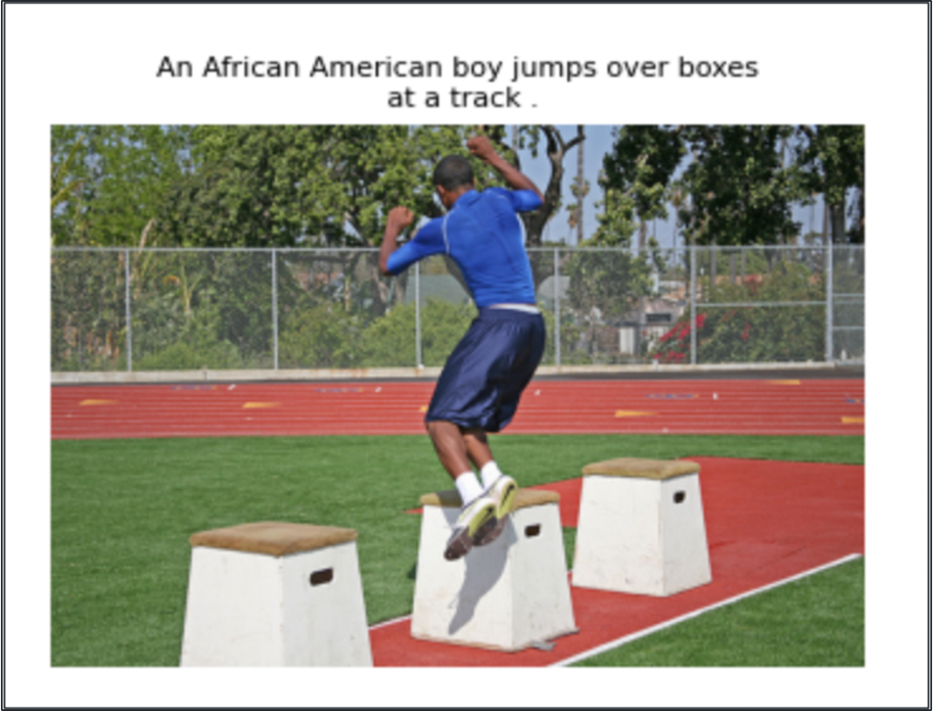
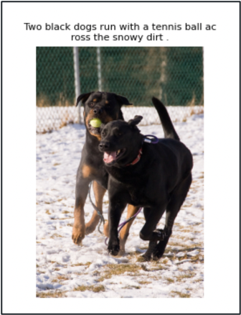
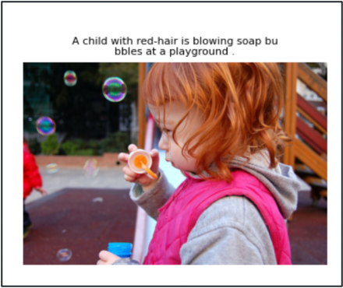
Introduction to our Data
The 'flickr30k' dataset consists of 31,783 images, each accompanied by 5 captions focused on people involved in everyday activities and events

Slide 6
02
Data Exploration

Slide 7
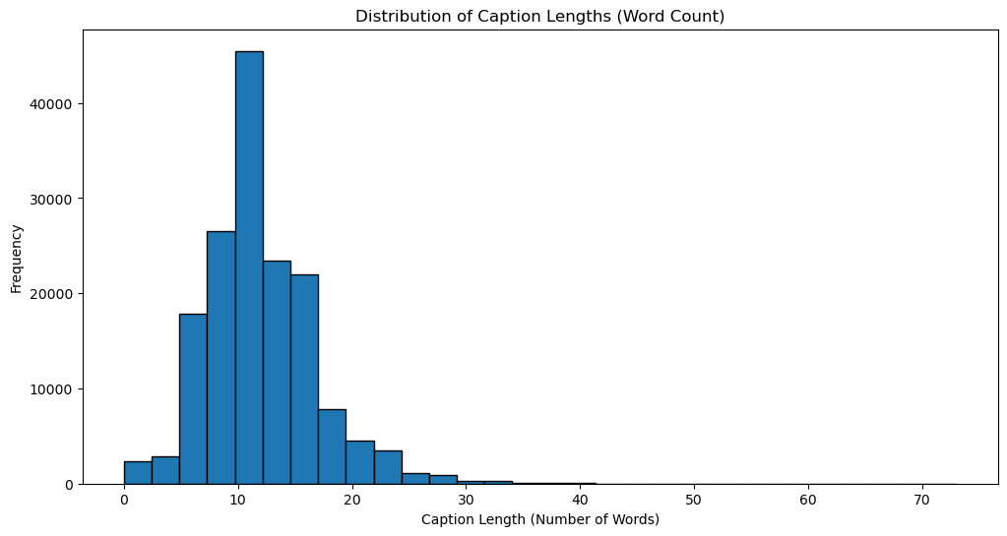
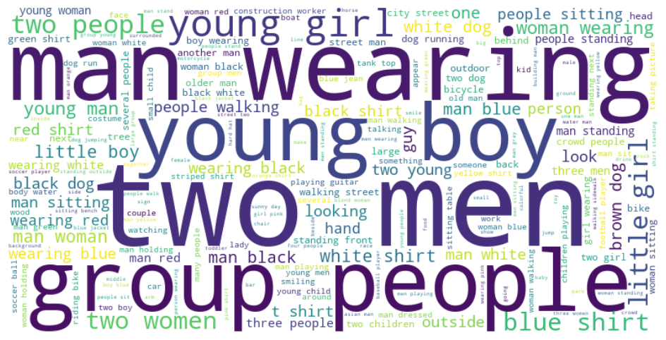
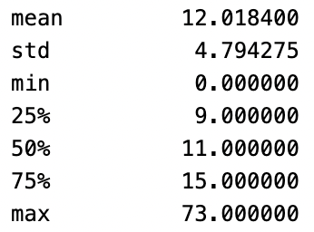
Textual Analysis of Image Captions
Distribution of Caption Lengths (Word count)
Word frequency
Average caption contains approximately 12 words,
with most captions ranging between 9 and 15 words
The captions include frequent mention of young individuals and apparel

Slide 8
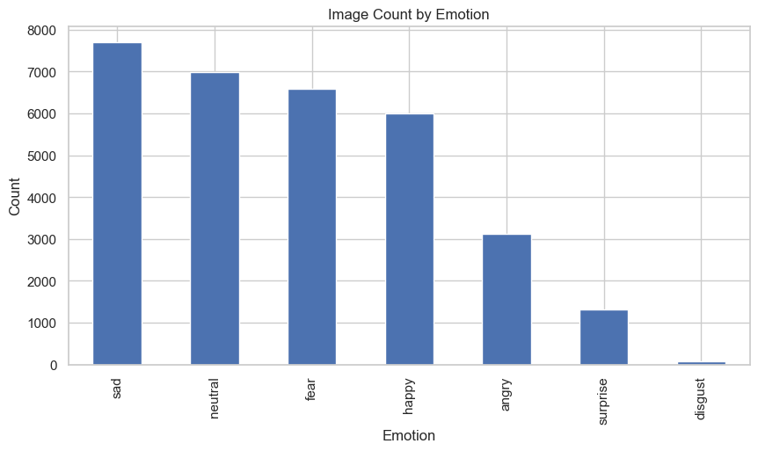
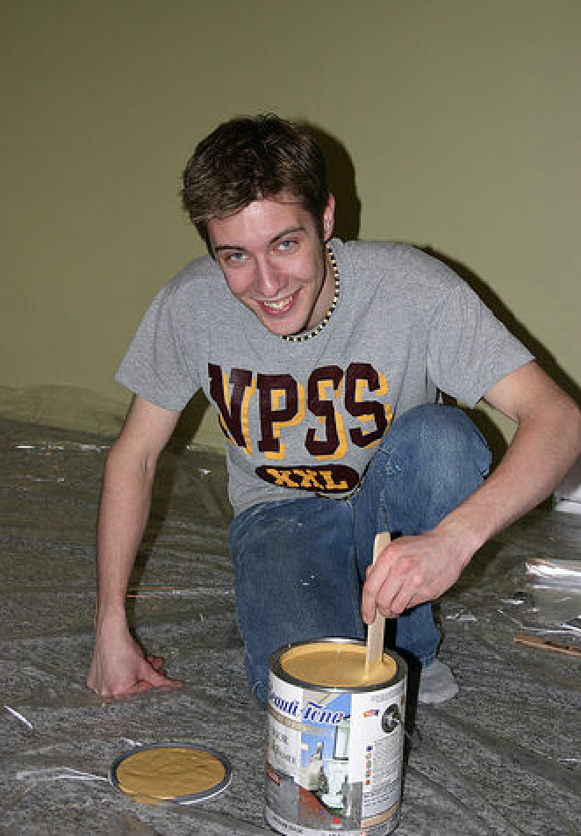
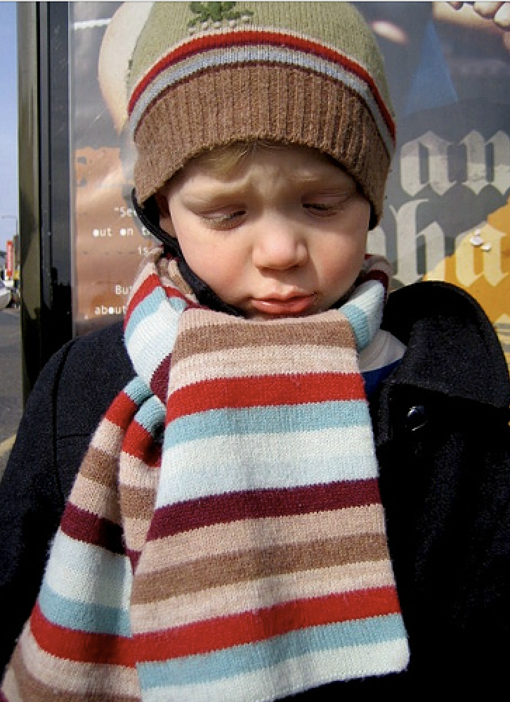
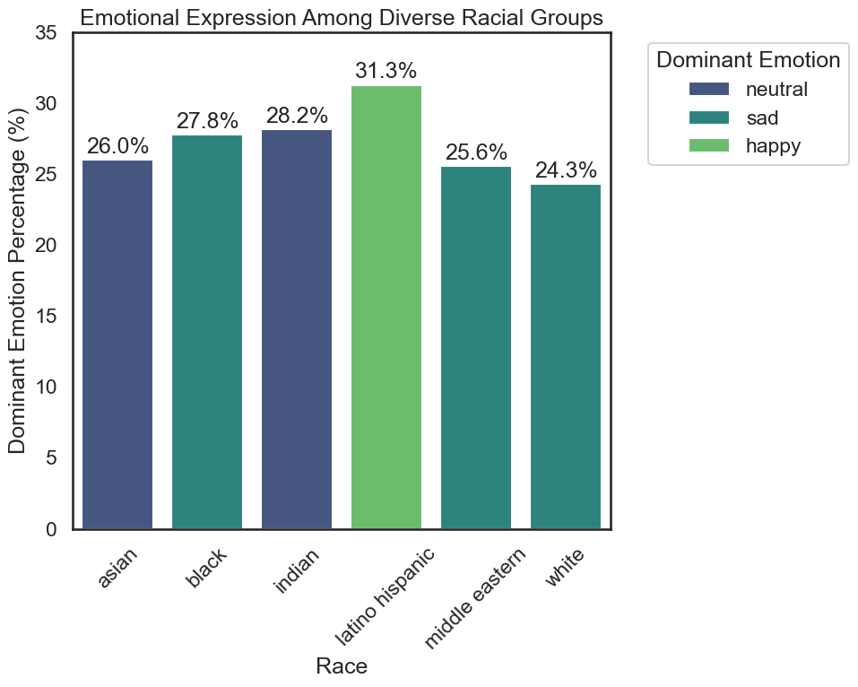
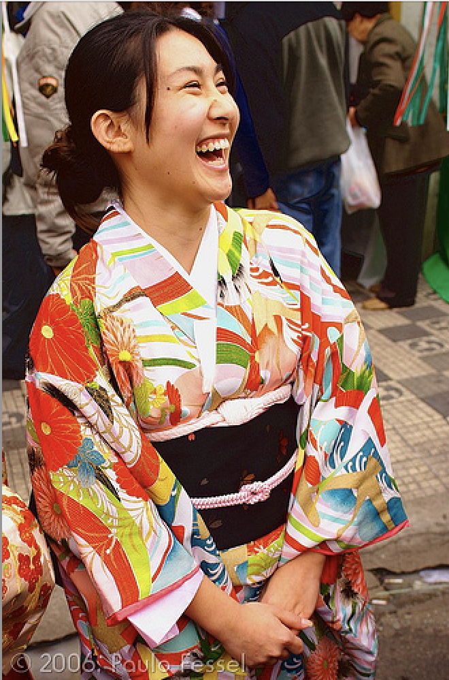
Analyzing Demographic Emotions
Leveraged Deepface for image analysis to detect emotions, gender, race and age of people
Gender Distribution: 94.3% were identified as men and 5.7% as women.
Race Distribution: The majority of humans were identified as white (78.5%), followed by Asian (9.6%), Black (6.1%) and others
Emotion Distribution: The predominant emotion is sadness (24.2%), closely followed by neutral expressions (22.0%) and fear (20.7%). Happiness is present in 18.9% of cases, while anger is at 9.8%.

Slide 9
03
Methodology

Slide 10
Approach 1:

Slide 11
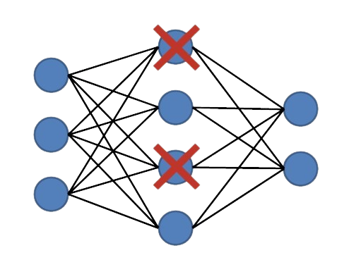
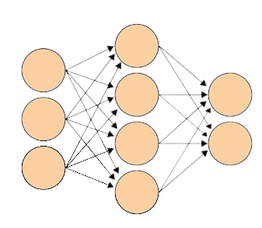
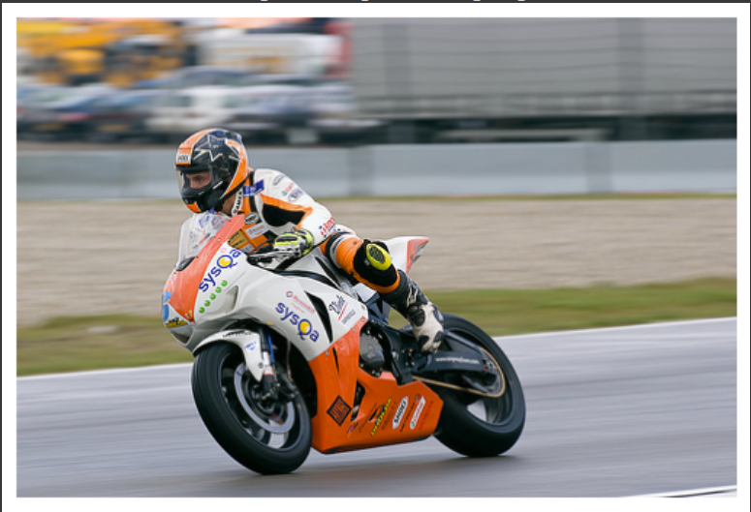
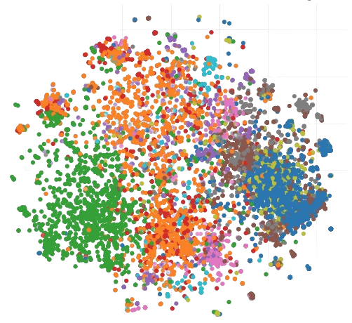
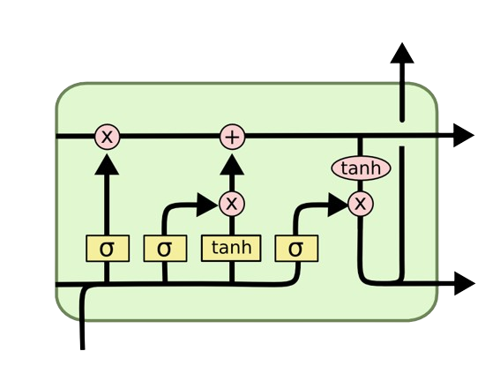
Architecture (using ResNet and LSTM)
Inputs
Encoded Image
Dropout
Dense
Output
∑
Dense 1
Softmax
Next Word
bike
Input Sequence
with
Embedding
Dropout
LSTM
helmet
‘A man on’
‘A man on bike’
‘A man on bike with’
Iterate till stop word is reached / max length
Notes:
This slide provides a comprehensive overview of the key layers in our neural network architecture for image captioning. This breakdown offers a clear understanding of how the model transforms input data and makes informed predictions, bridging the gap between images and language.

Slide 12
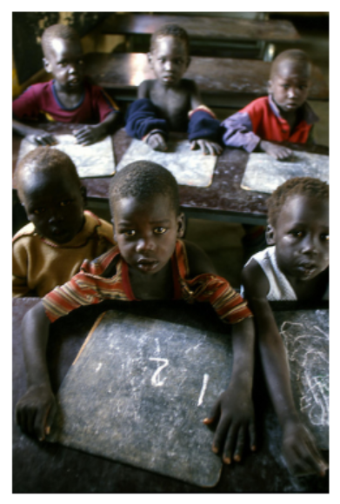
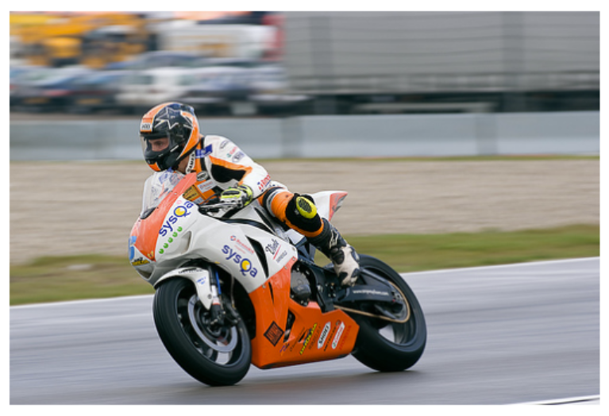
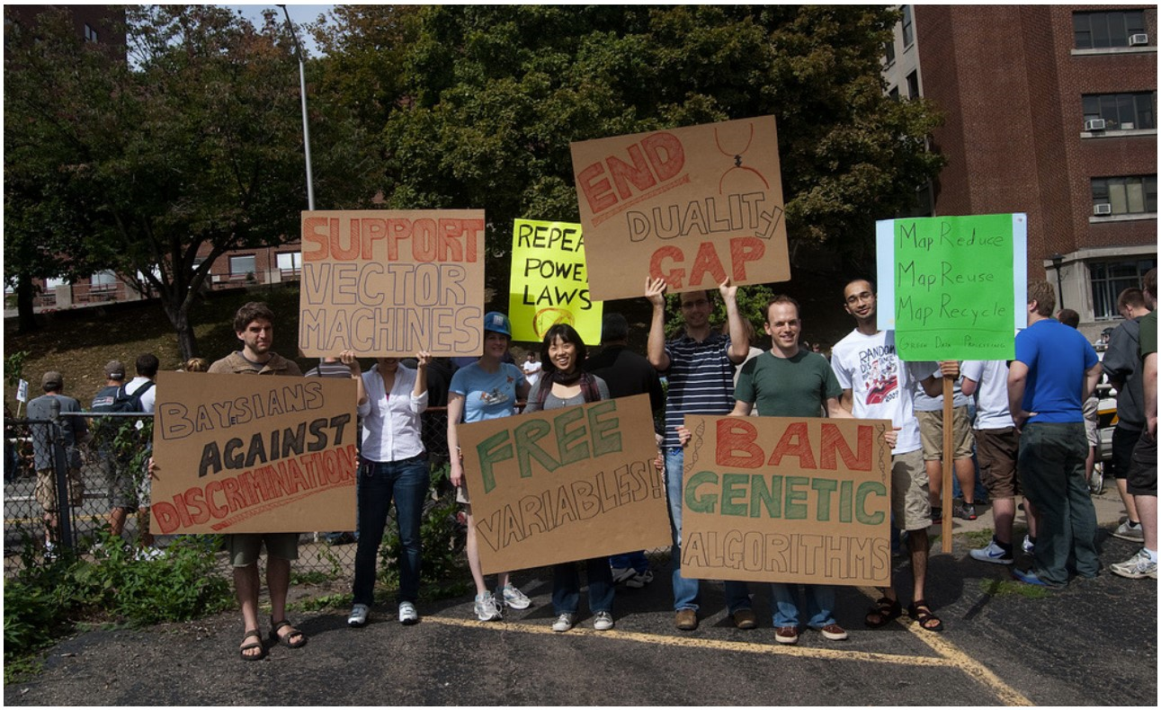
Sample captions
man in helmet and helmet rides bike
two children are sitting on the ground laughing
group of people are sitting on bench and one is standing on the phone

Slide 13
Approach 2:

Slide 14
Step 1: ImageEncoder
Generate Feature Embeddings from Images Using CLIP

Slide 15
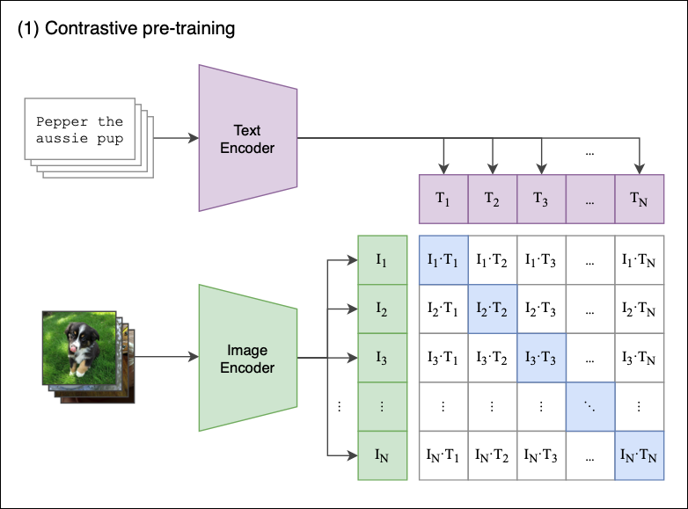
What is CLIP?
CLIP or Contrastive Language–Image Pretraining is used to generate features from images by transforming them into high-dimensional vectors (or embeddings)
What makes CLIP special compared to other models, such as ResNet, Inception, or VGG?
Contextual Understanding: CLIP links visual elements to natural language effectively, unlike traditional models like ResNet or VGG, which may lack contextual interpretation
Zero-Shot Learning Proficiency: Unlike models like VGG, CLIP categorizes and understands new, unseen images, applying learned concepts to novel instances
Alignment with Language Models: CLIP's embeddings align closely with language models for coherent text generation, a feature not inherent in classification-focused models like ResNet

Slide 16
From Input to Transformer Encoder
CLIP comprises two main components: the CLIPProcessor and the Vision model
CLIProcessor
Vision Model
Output
The CLIPProcessor prepares images for the CLIP model, resizing them to 224x224 pixels, normalizing to fit the model’s criteria, and converting them into PyTorch tensors
The Vision component comes pre-loaded with weights optimized for image processing
It analyzes images and extracts key visual features
The ImageEncoder yields a 1D tensor, sized at 512 dimensions, which encapsulates the key features of the input image
This tensor is then passed on to the Transformer Encoder for further processing, linking the image's visual information to subsequent model stages.

Slide 17
Step 2: Mapping
Transform image embeddings for compatibility with GPT-2 via a TransformerEncoder

Slide 18
Bridging Images to Text
CLIP Embeddings
TransformerEncoder + Linear Layer
GPT-2
The Mapping module acts as a crucial intermediary between the image encoding (CLIP model) and text decoding (GPT-2 model) components
It transforms the image embeddings from the CLIP model into a format suitable for the GPT-2 model
This involves a Transformer encoder for abstracting and refining the embeddings, followed by a linear layer which adjusts the dimensions to match those expected by the GPT-2 model
The mapping ensures seamless integration of the visual information encoded in the image embeddings with the text generation capabilities of GPT-2
The final output of the Mapping module is a set of transformed embeddings, now compatible with the GPT-2 model, ready to be used in the generation of textual captions for images

Slide 19
Step 3: TextDecoder
Utilize GPT-2 for text generation from embeddings

Slide 20
Translate Embeddings into Textual Captions
Mapping Module Output
GPT2Tokenizer
GPT-2 Model
The TextDecoder utilizes the GPT-2 model (GPT2LMHeadModel) to translate numerical embeddings into coherent text, serving as a key interface for text generation in the image captioning process
It employs GPT2Tokenizer to convert the generated tokens into human-readable text and to handle special tokens, such as the end-of-sentence (eos) token
During its forward pass, the TextDecoder takes in embeddings, processes them through the GPT-2 model to generate logits, which are raw predictions representing a probability distribution over the vocabulary for each word in the sequence.
It is responsible for generating human-readable text captions from processed embeddings, acting as the final step in converting image information into textual descriptions.

Slide 21
Step 4: Personalized Content Generation
Utilize GPT-3.5 for personalized content generation

Slide 22
Adapting for User Preferences
In this step, GPT-2 first generates a caption based on the processed embeddings and then we focus on advanced processing and enhancement of generated captions
Caption from GPT-2
1. Specify the tone of the caption
2. Translate the caption to another language
3. Get more information about items mentioned in the caption
This allows for customization based on whether a more formal, sophisticated language is preferred or a casual, conversational style is more appropriate
This is particularly useful for multilingual audiences or for sharing information across diverse linguistic groups. The translation should aim to maintain the original meaning and context of the caption
When the user opts for option 3, NLTK and spaCy are utilized to identify key nouns and proper nouns from the caption, enabling the provision of detailed information on these specific words

Slide 23
04
Output

Slide 24
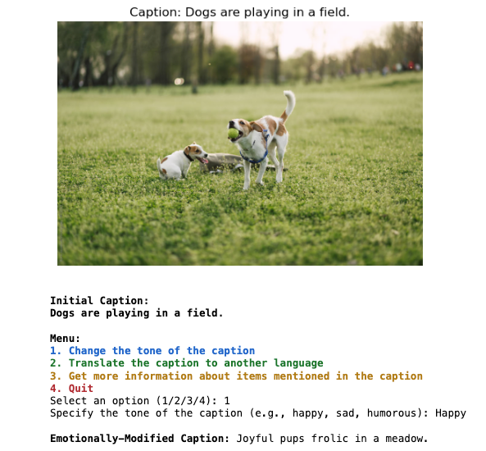
1. Specify the tone of the caption

Slide 25
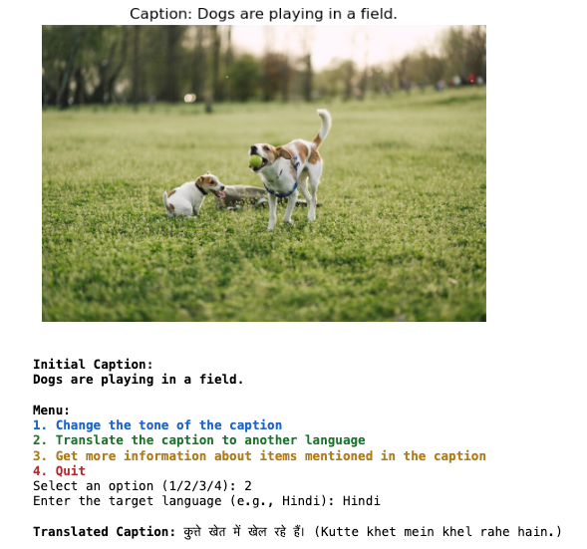
2. Translate the caption to another language

Slide 26
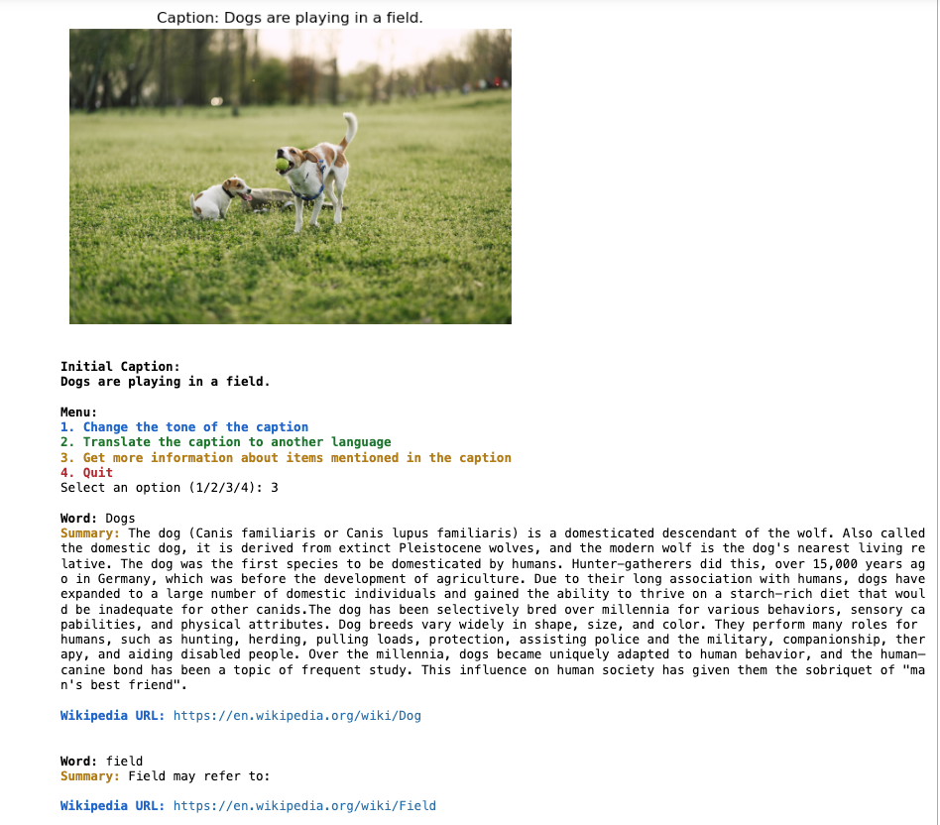
3. Get more information about items mentioned in the caption

Slide 27
05
Next Steps

Slide 28
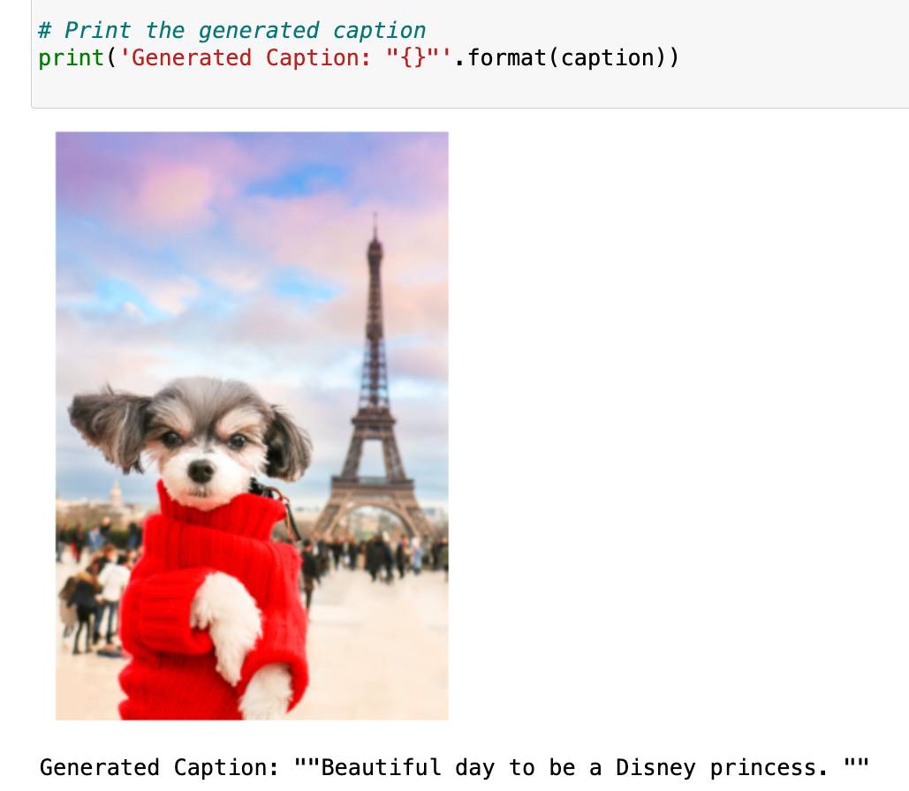
Clearly the model needs improvement

Slide 29
Potential Improvements
Image Recognition and Caption Generation: When a user uploads any image, the system employs advanced image recognition technology to identify key elements or landmarks
An AI-generated caption is created, incorporating the identified features of the image
Interactive User Customization: The system then interacts with the user to ascertain their specific interests or queries related to the image. This step is crucial for understanding the context in which the user is viewing or using the image
Tailored Information and Recommendations: Depending on the user's response, the system provides customized information or recommendations. This could include-
Travel information, historical or cultural details about identified landmarks.
Suggestions for activities or places of interest in the vicinity of the recognized location in the image.
Any other relevant information or services based on the content of the image (e.g., if it's a product, links to similar products or purchasing options)
Language and Tone Adaptation: The system offers to display the information in various languages and adjust the communication style to match the user's preference, enhancing accessibility and user engagement

